Slide 1
Databases

Slide 2
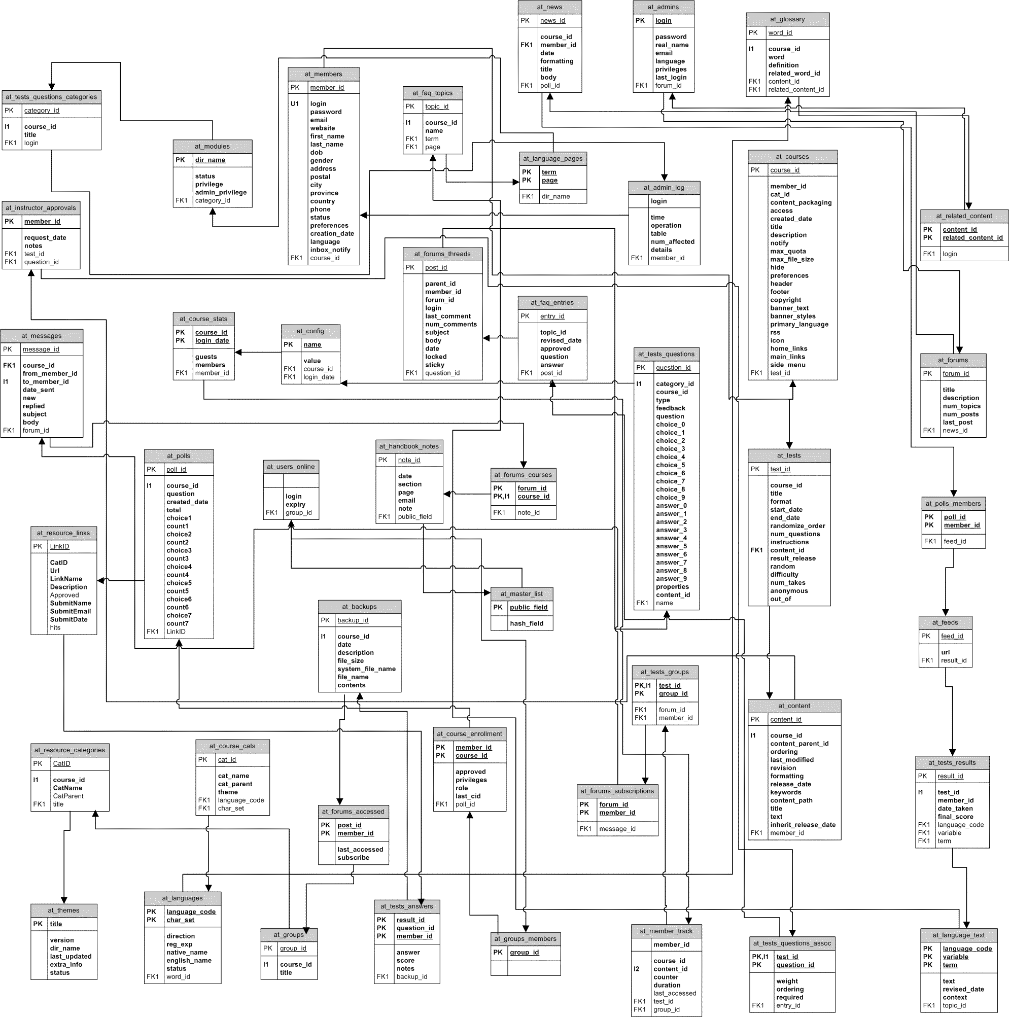

Slide 3
Introduction to DB

Slide 4
What is a database?
Database = a very large, integrated collection of related data items stored for record-keeping and analysis, that exist over a long period of time.
&
models the real-world activity through a
Data Model

Slide 5
Data Models
A data model is a collection of concepts for describing data:
structures
relationships
semantics
consistency constraints.
A schema is a description of a particular collection of data, using the given data model.

Slide 6
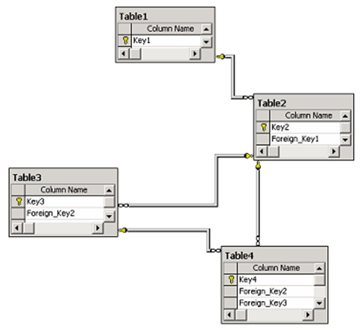
Relational Model
Early 1970’s Ted Codd invented new data model Relational Model and the concept of data abstraction
Soon thereafter, team of IBM’ers invented SQL (Structured Query Language)

Slide 7
Schema vs. Data
Database state refers to the data in the database at any given moment (snapshot)
Changes frequently
a.k.a. database extension
DBMS assures that all database states are valid states
Database Instance refers to a specific data item in the database

Slide 8
What is a DBMS?
A Database Management System (DBMS) is a collection of programs that:
allows users to create a new database and specify its schema
gives users the ability to query and modify the data efficiently
keeps the data secure from accidents or unauthorized use
controls the access to the data for many users at once
The database and DBMS software together make up what is known as the Database System.
Using Flat Files for Storing Data (?)

Slide 9
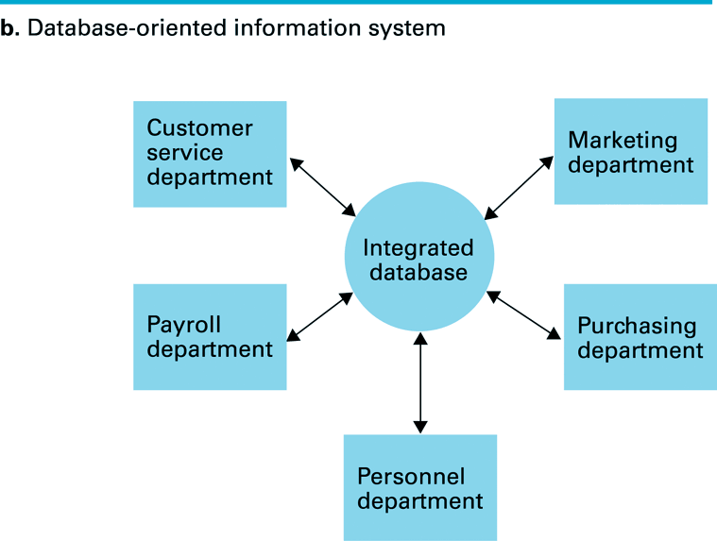
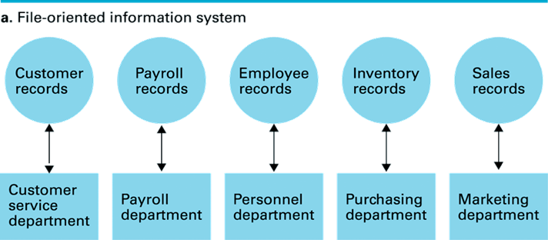
Flat Files vs. Database Organization
a. Flat file is considered to be one-dimensional storage system
b. Database refers to a multidimensional storage

Slide 10
Levels of Abstraction
Many external schemas (views), single conceptual (logical) schema and physical (internal) schema.
Views describe how users see the data.
Conceptual schema defines logical structure
Physical schema describes the files and indexes used
View 1
View 2
View 3
Conceptual Schema
Physical Schema
Disk

Slide 11
Example: University Database
Conceptual schema:
Students(sid:string, name:string, email:string, age:integer, gr:integer)
Courses(cid: string, cname: string, credits:integer)
Enrolled(sid:string, cid:string, grade:integer)
Teachers(tid:integer; name: string; sal : integer)
Teaches(tid:integer; cid:integer)
Physical schema:
Relations stored as unordered files.
Index on first column of Students.
External Schema (View):
Course_info(cid:string, enrollment:integer)

Slide 12
DBMS Languages

Slide 13
DBMS Languages
Data Definition Language (DDL)
Used to define the conceptual and internal schemas
Includes constraint definition language (CDL) for describing conditions that database instances must satisfy
Includes storage definition language (SDL) to influence layout of physical schema (some DBMSs)
Data Manipulation Language (DML)
Used to describe operations on the instances of a database
Procedural DML (how) vs. declarative DML (what)
Note, SQL includes a DML and a DDL in one!
Host Language
General-purpose programming language which lets users embed DML commands (data sublanguage) into their code

Slide 14

DML Commands: SELECT
To find all 21 years old students, we can write:
FROM -> predefined word used to specify the set from where you want to read the informations (ex. the table)
WHERE -> adds a filter that will be applied to the set specified in the FROM clause
SELECT -> selects the fields from the new formed set that the user wants to be returned (use * if you want to return all the fields from the set)
To find just names and email addresses, replace the first line:
SELECT *
FROM Students S
WHERE S.age = 21
1234 | John | j@cs.ro | 21 | 331
1236 | Anne | a@cs.ro | 21 | 332
SELECT S.name, S.email

Slide 15
Querying Multiple Relations
What does the following query compute?
Given the following instances of Students and Enrolled
SELECT S.name, E.cid
FROM Students S, Enrolled E
WHERE S.sid=E.sid AND E.grade=10
Students
Enrolled
We get:
sid | name | email | age | gr
1234 | John | j@cs.ro | 21 | 331
1235 | Smith | s@cs.ro | 22 | 331
1236 | Anne | a@cs.ro | 21 | 332
sid | cid | grade
1234 | Alg1 | 9
1235 | Alg1 | 10
1234 | DB1 | 10
1234 | DB2 | 9
S.name | E.cid
John | DB1
Smith | Alg1
Using two tables in the FROM clause, creates a cartesian product between the two tables -> Each row in the first table is paired with all the rows in the second table
The resulting table will be stored into the memory and the filters from the WHERE clause will be applied on it
After the filters are applied, from the resulting table, only the columns specified in the SELECT clause will be returned

Slide 16
Semantics of a Query
A conceptual evaluation method for the previous query:
1. FROM clause: Compute cross-product of Students and Enrolled
2. WHERE clause: Check conditions, discard tuples that fail
3. SELECT clause: Delete unwanted fields
Remember, this is conceptual. Actual evaluation will be much more efficient, but must produce the same answers.

Slide 17

Find students with at least one grade
All the students are stored in the table Students
The table Enrolled specifies every studentid with a grade registered at a courseid
For a student to have at least one grade => its studentid should appear in the Enrolled table
Questions:
Would adding DISTINCT to this query make a difference?
What is the effect of replacing S.sid by S.sname in the SELECT clause? Would adding DISTINCT to this variant of the query make a difference?

Slide 18

Expressions and Strings
The working table will be the one specified by the FROM clause: Students table
The filter from the WHERE clause will remove all of the rows from the table, that do not have in the field name, a name that starts and ends with the letter B, and it contains at least three letters (B + one arbitrary character + 0 or more characters + B)
In the SELECT clause there are three fields returned::
first filed is the column age (int) from the table students,
the second column is an user created column, age1, which will be created from substracting 5 from the age
the third column will be another user created column, age2,which will be created from multiplying the age column with 2
Illustrates use of arithmetic expressions and string pattern matching: Find triples (of ages of students and two fields defined by expressions) for students whose names begin and end with B and contain at least three characters.
AS and = are two ways to name fields in result.
LIKE is used for string matching. `_’ stands for any one character and `%’ stands for 0 or more arbitrary characters.

Slide 19
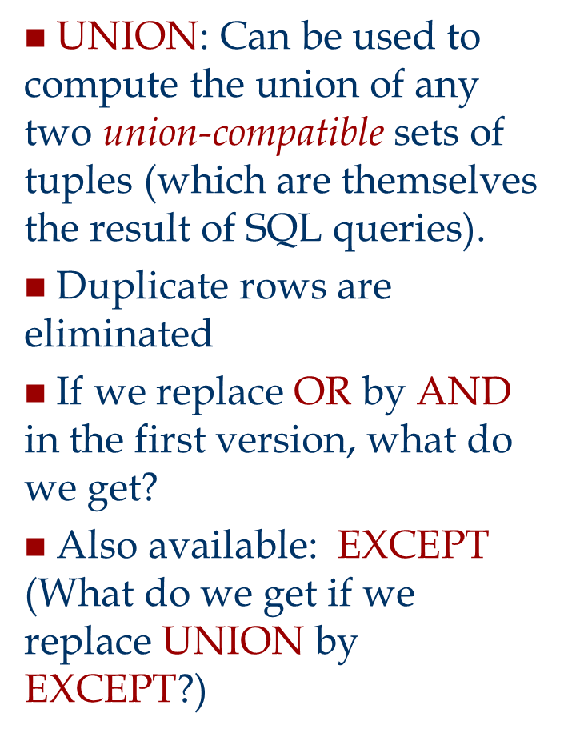
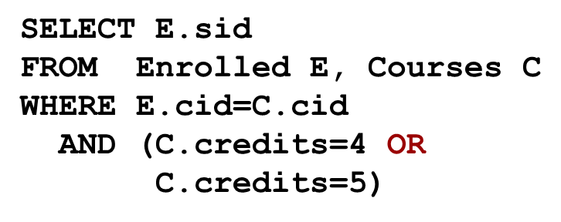
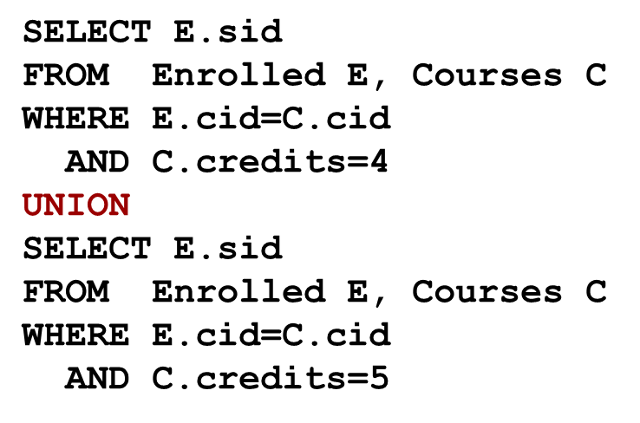
Find sid of students with grades at courses with 4 or 5 credits
Both queries above produce the same results

Slide 20
Find sid of students with grades at courses with 4 or 5 credits (cont)
In the FROM clause the cross product will be created from the two tables Enrolled and Courses
In the WHERE clause only the rows thathave the same cid from both tables, will remain
To find the student ids that have grades only at courses with 4 and 5 credits, in the WHERE clause there is another filter added, that only selects the rows where the field credits is either 4 OR 5

Slide 21
Find sid of students with grades at courses with 4 or 5 credits (cont)
The first query will only return the student ids that are enrolled in courses with 4 credits
The second query will only return the student ids that are enrolled in courses with 5 credits
The UNION clause will take both returned sets from both queries, apply DISTINCT on the resulting set and return it as final
If applying UNION ALL instead of UNION, the resulting set will also contain duplicates => UNION ALL does not apply DISTINCT on the resulting set
The difference in execution speed comes from the fact UNION requires internal temporary table with index (to skip duplicate rows) while UNION ALL will create table without such index.
When applying UNION or UNION ALL on two or more sets, all returned sets should have the same number of fields and the every field should have the same name and datatype

Slide 22
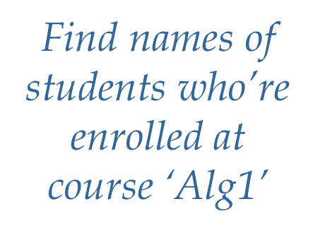
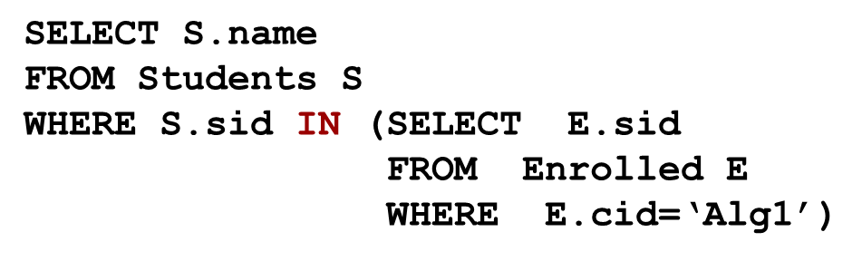
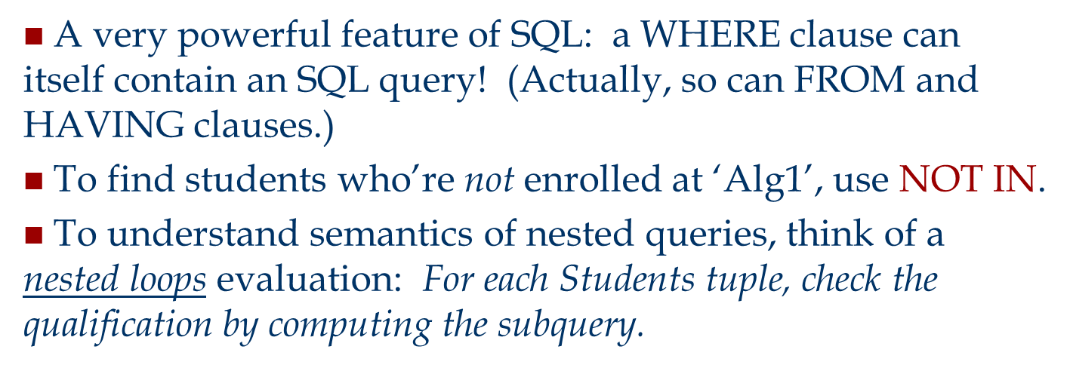
Nested Queries

Slide 23
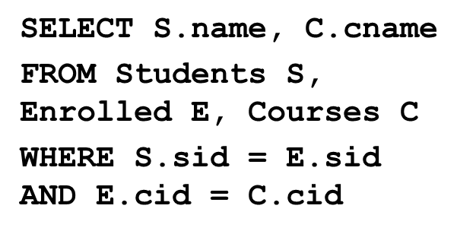
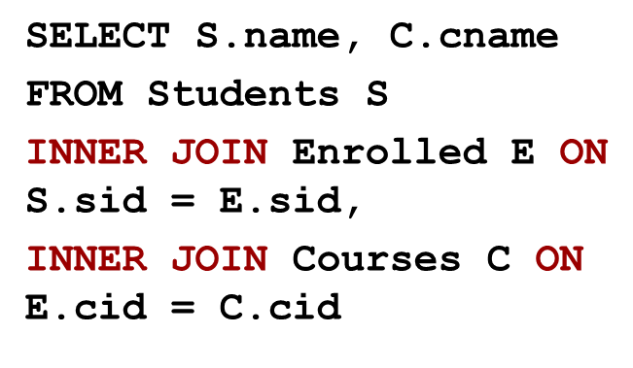

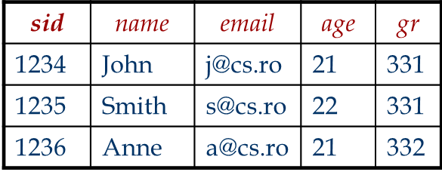
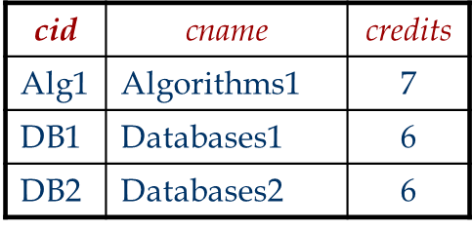


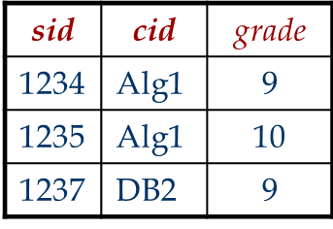

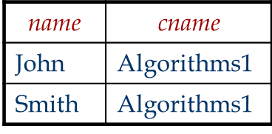

Join Queries
Notes:
CROSS JOIN - a Cartesian product of both tables. ALL joins begin here
INNER JOIN - a CROSS JOIN with a filter added.
Cross Joins produce results that consist of every combination of rows from two or more tables. That means if table A has 6 rows and table B has 3 rows, a cross join will result in 18 rows. There is no relationship established between the two tables – you literally just produce every possible combination.
With an inner join, column values from one row of a table are combined with column values from another row of another (or the same) table to form a single row of data.
If a WHERE clause is added to a cross join, it behaves as an inner join as the WHERE imposes a limiting factor.

Slide 24

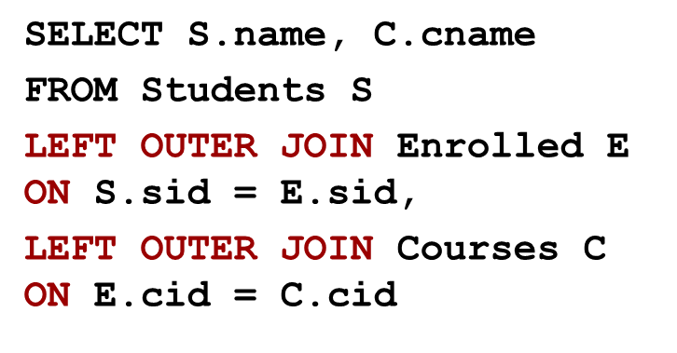
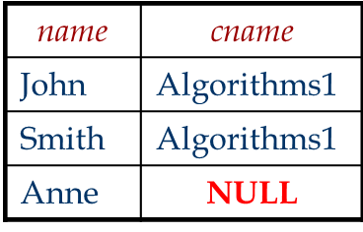
Outer Queries
Notes:
LEFT OUTER JOIN - fetches data if present in the left table.

Slide 25
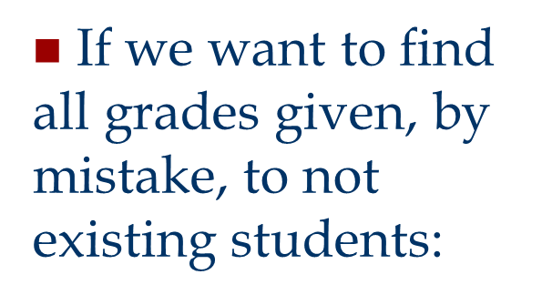
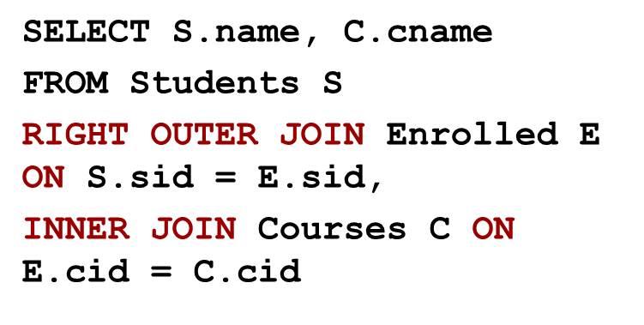
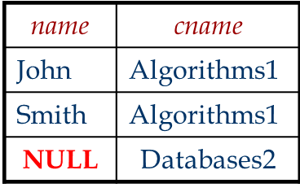
Outer Queries (cont.)
Notes:
fetches data if present in the right table.

Slide 26
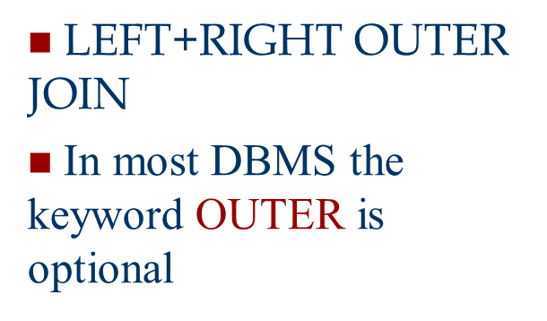
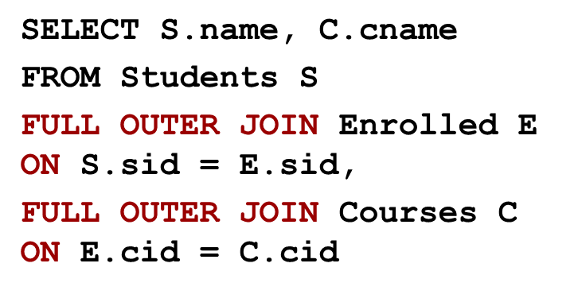
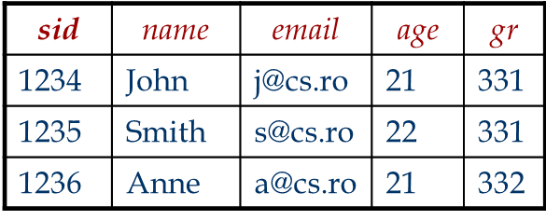
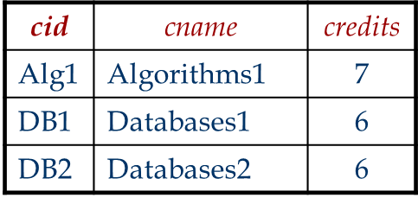


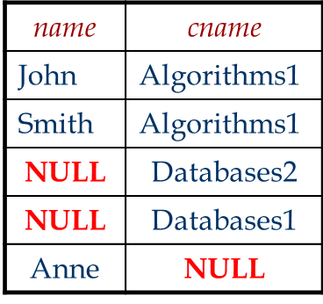
Full Outer Join
Notes:
fetches data if present in either of the two tables.

Slide 27
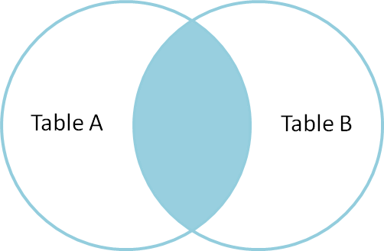
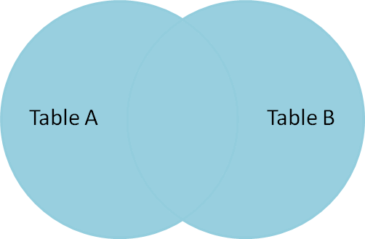
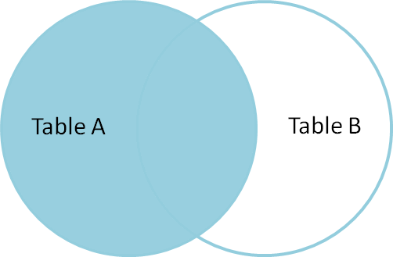
Join Queries
INNER JOIN
LEFT OUTER JOIN
FULL OUTER JOIN

Slide 28
Join Queries
There are mainly three types of JOIN
Inner: fetches data, that are present in both tables
Only JOIN means INNER JOIN
Outer: are of three types
LEFT OUTER - - fetches data present only in left table & matching condition
RIGHT OUTER - - fetches data present only in right table & matching condition
FULL OUTER - - fetches data present any or both table
(LEFT or RIGHT or FULL) OUTER JOIN can be written without writing "OUTER”
Cross Join: joins everything to everything
Notes:
fetches data if present in either of the two tables.

Slide 29
Null Values
Field values in a tuple are sometimes unknown (e.g., a rating has not been assigned) or inapplicable.
SQL provides a special value null for such situations.
The presence of null complicates many issues. E.g.:
Special operators needed to check if value is/is not null.
Is rating>8 true or false when rating is equal to null? What about AND, OR and NOT connectives?
We need a 3-valued logic (true, false and unknown).
Meaning of constructs must be defined carefully. (e.g., WHERE clause eliminates rows that don’t evaluate to true.)
New operators (in particular outer joins) possible/needed.

Slide 30
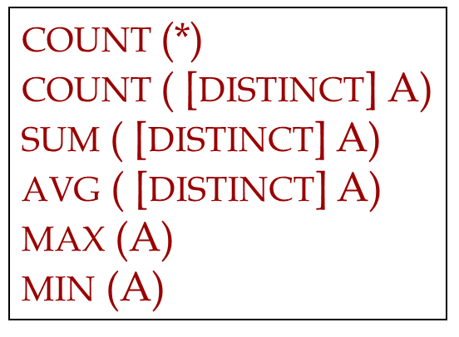


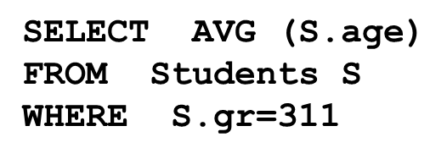

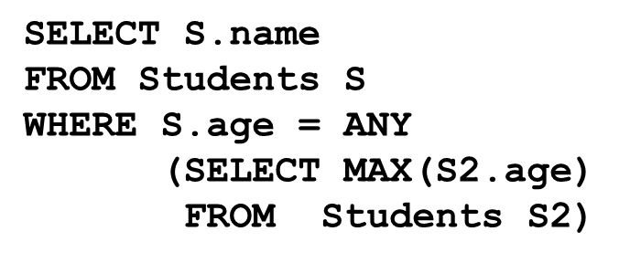
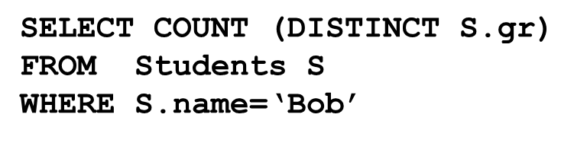
Aggregate Operators

Slide 31
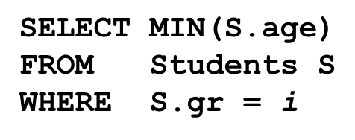

GROUP BY and HAVING
So far, we’ve applied aggregate operators to all (qualifying) tuples. Sometimes, we want to apply them to each of several groups of tuples.
Consider: Find the age of the youngest student for each group.
In general, we don’t know how many groups exist
Suppose we know that rating values go from 110 to 119, we can write 10 queries that look like this (!):

Slide 32
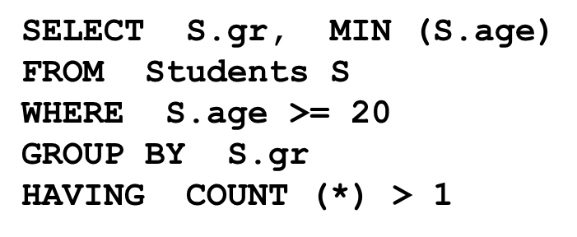
GROUP BY/HAVING - Example
Find the age of the youngest student with age ≥ 20 for each group with at least 2 such students
Only S.gr and S.age are mentioned in the SELECT, GROUP BY or HAVING clauses; other attributes `unnecessary’.
2nd column of result is unnamed. (Use AS to name it.)

Slide 33
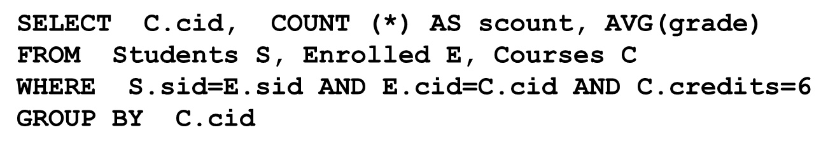


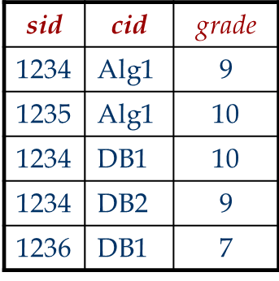

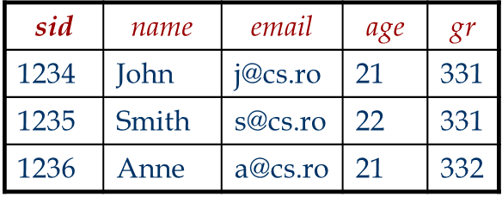
Find the number of enrolled students and the grade average for each course with 6 credits

Slide 34
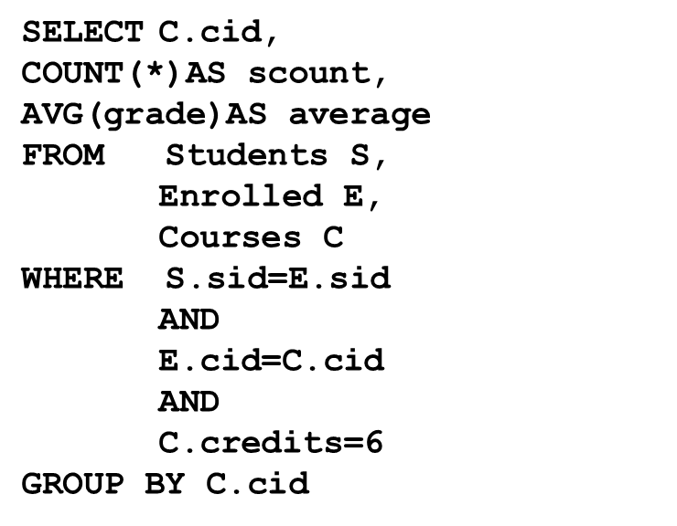
Students
Enrolled
sid | name | email | age | gr
1234 | John | j@cs.ro | 21 | 331
1235 | Smith | s@cs.ro | 22 | 331
1236 | Anne | a@cs.ro | 21 | 332
1234 | John | j@cs.ro | 21 | 331
1235 | Smith | s@cs.ro | 22 | 331
1236 | Anne | a@cs.ro | 21 | 332
1234 | John | j@cs.ro | 21 | 331
1235 | Smith | s@cs.ro | 22 | 331
1236 | Anne | a@cs.ro | 21 | 332
1234 | John | j@cs.ro | 21 | 331
1235 | Smith | s@cs.ro | 22 | 331
1236 | Anne | a@cs.ro | 21 | 332
1234 | John | j@cs.ro | 21 | 331
1235 | Smith | s@cs.ro | 22 | 331
1236 | Anne | a@cs.ro | 21 | 332
sid | cid | grade
1234 | Alg1 | 9
1234 | Alg1 | 9
1234 | Alg1 | 9
1235 | Alg1 | 10
1235 | Alg1 | 10
1235 | Alg1 | 10
1234 | DB1 | 10
1234 | DB1 | 10
1234 | DB1 | 10
1234 | DB2 | 9
1234 | DB2 | 9
1234 | DB2 | 9
1236 | DB1 | 7
1236 | DB1 | 7
1236 | DB1 | 7
Notes:
The table above is the product of a cross join between the tables Students and Enrolled.
In the Where clause there is a filter applied on the resulted table, which will only select, for the next operations, the highlighted lines.
All of the tables from this slide, and the next two slides are not physical tables, but tables created in the memory to executes all the statements from the query.

Slide 35
Students
Enrolled
Courses
sid | name | email | age | gr
1234 | John | j@cs.ro | 21 | 331
1235 | Smith | s@cs.ro | 22 | 331
1234 | John | j@cs.ro | 21 | 331
1234 | John | j@cs.ro | 21 | 331
1236 | Anne | a@cs.ro | 21 | 332
sid | cid | grade
1234 | Alg1 | 9
1235 | Alg1 | 10
1234 | DB1 | 10
1234 | DB2 | 9
1236 | DB1 | 7
cid
cname
credits
Alg1
Algoritmics 1
7
Alg1
Algoritmics 1
7
DB1
Databases1
6
DB2
Databases2
6
DB1
Databases1
6
SELECT C.cid, COUNT(*)AS scount, AVG(grade)AS average FROM Students S, Enrolled E, Courses C WHERE S.sid=E.sid AND E.cid=C.cid AND C.credits=6 GROUP BY C.cid
Notes:
With the result from the first join and filter, the table from the previous slide, there is another cross join done, with the table Courses => the table above.
On the table there are two filters applied, wich will result in only taking into consideration, for the next operations, only the highlighted rows, according to the filters.

Slide 36
sid | name | email | age | gr
1234 | John | j@cs.ro | 21 | 331
1234 | John | j@cs.ro | 21 | 331
1236 | Anne | a@cs.ro | 21 | 332
sid | cid | grade
1234 | DB1 | 10
1234 | DB2 | 9
1236 | DB1 | 7
cid | cname | credits
DB1 | Databases1 | 6
DB2 | Databases2 | 6
DB1 | Databases1 | 6
cid
scount
average
SELECT C.cid, COUNT(*)AS scount, AVG(grade)AS average FROM Students S, Enrolled E, Courses C WHERE S.sid=E.sid AND E.cid=C.cid AND C.credits=6 GROUP BY C.cid
DB1
2
8.5
DB2
1
9
HAVING MAX(grade) = 10
Notes:
On the three rows that were resulted from the previous table (previous slide), there is GROUP BY statement applied. The result will be a list of distinct courses ids (cid) and the number of times every course id (cid) will appear:
- DB2 appears only once for sid = 1234
- DB1 appears twice for sid = 1234 & sid = 1236
On the resulting table , with only two rows, there is a HAVING statement applied, which will eliminate the row where the isn’t a grade column that is equal to 10:
- DB1 appears twice, once with grade = 10 and once with grade = 7 => after the HAVING filter, the cid = DB1 should remain
- DB2 appears once with grade = 9 => after the HAVING filter the cid = DB2 will be eliminated

Slide 37

Adding, Deleting and Updating Tuples
INSERT INTO Students (sid, name, email, age, gr)
VALUES (53688, ‘Smith’, ‘smith@math’, 18, 311)
Can delete all tuples satisfying some condition
DELETE FROM Students S
WHERE S.name = ‘Smith’
Can modify the columns values using:
UPDATE Students S
SET S.age=S.age+1
WHERE S.sid = 53688

Slide 38
Summary
SQL was an important factor in the early acceptance of the relational model; more natural than earlier, procedural query languages.
Relationally complete; in fact, significantly more expressive power than relational algebra.
Even queries that can be expressed in RA can often be expressed more naturally in SQL.
Many alternative ways to write a query; optimizer should look for most efficient evaluation plan.
In practice, users need to be aware of how queries are optimized and evaluated for best results.
NULL for unknown field values brings many complications

